Slide 1
Project Release Plan
TrafficDump™
v0.1 - Oct 9, 2018
Team Members:
Sepehr Raissian (Product Owner)
Alexis Flores (Initial Scrum Master)
Cameron Pon
Sinclair Liang
Gene Choi

Slide 2
Project Release Plan Cont.
Outline:
Have you wondered where your web requests go ?
Where are these mystical devices ?
Introducing TrafficDump!
TrafficDump is a web application that analyzes network traffic (such as DNS and HTTP requests) from network devices located inside and outside of campus, to provide valuable performance metrics and represents it as a list of graphical interfaces.
Using these metrics, TrafficDump be able to provide a location with the best network performance and the most efficient route to that location.

Slide 3
Project Release Plan Cont.
High level goal(s):
•Combination of Google Maps API with the UCSC Access Points to display where fastest/slowest connections.
•Trace-back using an IP address to mark a geographic location for that address
•Log network traffic and create some data visualization of it

Slide 4
Project Release Plan - User Stories
Sprint 1 (Current): Mapping out the network traffic trend
As a network analyst, I would like to observe and sample network traffic in my area so I know when the routers/Access Points are busiest.
As a student, I would like to know where on campus has the best network signal at a specific time so I can complete my assignments without network interruptions.

Slide 5
Project Release Plan - User Stories
Sprint 2: Network analysis with interactive visualization
As a network analyst or technician, I want to see a visual representation of network traffic of all the devices of interest so I can show clients with limited networking knowledge
As a student, I want to be able to see a graph of when a router/Access Point at the library is most busy so I can plan on working around it.
Sprint 3: Back-tracing network signals As a student with finals approaching, I would like to have a map with locations to the library’s Access Points with the best internet connection so that I can spend less time walking around and more time being productive.

Slide 6
Project Release Plan - Challenges/Risks
Challenge 1: Learning to become familiarized with all technologies that will be used.
Challenge 2: Weighing the benefits and cost of using resource intensive hardware or platforms.
Challenge 3: How to implement different frontend/backend features like web application platform, databases, etc.
Challenge 4: Finding time to meet that works everybody.

Slide 7
Project Release Plan - Technologies
Technology 1: Programming Languages
CSS, Javascript, Python
Technology 2: Web Applications
Django, Redux with React, Heroku
Technology 3: Others
AWS (DynamoDB), Mapcom with CiscoPrime

Slide 8
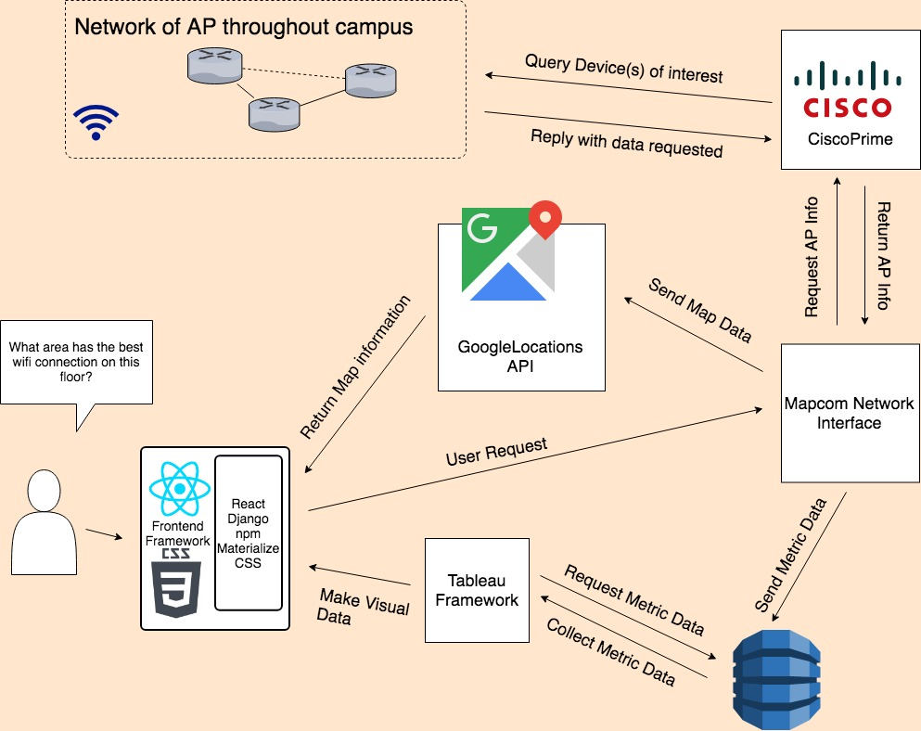
Project Release Plan - Architecture (Rough Draft 1)

